Slide 1

Project Overview
This presentation will provide a high-level overview of our upcoming key logger project in Python. We'll cover the key objectives, scope, and technical details to set the stage for the more in-depth discussions to follow.
BY ADARI SURENDRA

Slide 2

Key Logger in Python
Develop a powerful key logger application using the Python programming language. This robust tool captures and logs keystrokes on a target system, providing valuable insights for monitoring and security purposes.
Leverage the versatility of Python's libraries and modules to build a stealthy, efficient, and highly customizable key logging solution.

Slide 3

Project Objective
Capture Keystrokes
Log Data Securely
Enable Monitoring
The key logger will actively monitor and record all keystrokes made on the user's device, providing a comprehensive record of their computer usage and activity.
The captured keystroke data will be logged and stored in a secure manner, ensuring the privacy and confidentiality of the monitored information.
The key logger will enable the user or administrator to review the recorded keystrokes, providing valuable insights into the user's computer habits and activities.

Slide 4
Project Scope
Capturing Keystrokes
Secure Data Storage
Stealthy Background Operation
The key logger will be designed to capture every keystroke made on the target system, including passwords, login information, and other sensitive data.
The captured keystrokes will be stored securely, with robust encryption and access control measures, to prevent unauthorized access or tampering.
The application will run discreetly in the background, without drawing attention to itself, to maintain a covert monitoring presence on the target system.

Slide 5

Technical Requirements
To develop a robust key logger, the system must meet several technical requirements, including efficient data capture, secure storage, and undetectable operation.

Slide 6



Data Storage & Libraries
Data Storage
Python Libraries
Cloud Integration
The key logger will store captured keystrokes securely in a database or file system, ensuring the data is protected and accessible for analysis.
We will utilize robust Python libraries like pynput and keyboard to handle low-level input monitoring and event capture functionality.
For enhanced security and accessibility, we may also incorporate cloud storage solutions to back up and sync the key logger data across devices.

Slide 7
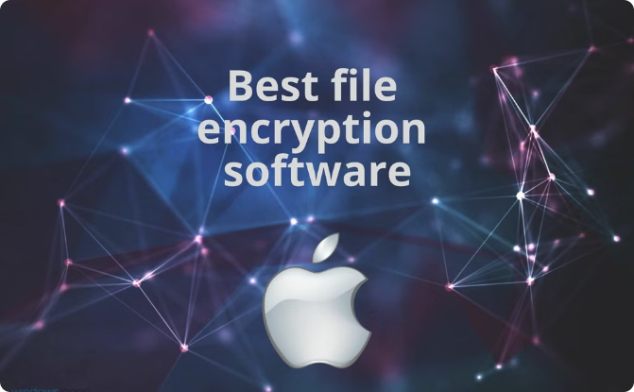

Security Considerations
Encryption
Access Control
Implement robust encryption algorithms to protect sensitive user data and keylogging output from unauthorized access or interception.
Ensure strict access control measures are in place, allowing only authorized personnel to view or manage the collected keylogging data for enhanced privacy and compliance.

Slide 8

Potential Challenges and Mitigation Strategies
Data Privacy and Security
Ethical Considerations
Detection and Avoidance
Addressing the ethical implications of monitoring user input without explicit consent. Develop a clear policy on acceptable use and obtain necessary approvals.
Ensuring the captured keystrokes are stored securely and not accessed by unauthorized parties. Implement robust encryption and access controls.
Preventing the key logger from being detected by antivirus software or users. Utilize stealth techniques and obfuscation to minimize the application's footprint.

Slide 9
Development and Deployment
Implementation
1
Develop the key logger using Python and the pynput library
Data Storage
2
Implement secure data storage mechanisms to protect the logged keystrokes
Deployment
3
Package the application for seamless deployment on target systems
The key logger development will focus on leveraging the pynput library to capture keystrokes in a stealthy manner. Robust data storage solutions will be incorporated to ensure the logged data is securely stored and protected. Finally, the application will be packaged for efficient deployment on the target systems, enabling widespread monitoring capabilities.

Slide 10
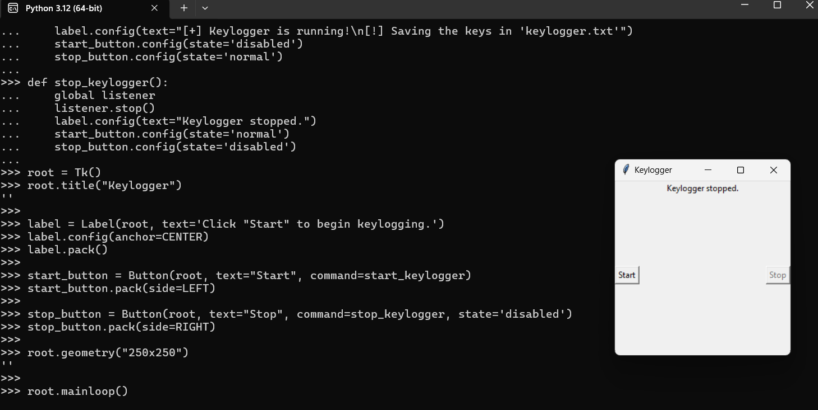

Slide 11

https://github.com/surendraadari/keylogers-skillbuild.git
CLICK Ctrl + click the link

Slide 12

Development, Deployment, Documentation, Review and Feedback
To complete the project, the key logger application must be successfully deployed on the target systems. Ongoing monitoring and maintenance will be crucial to ensure the application continues to run stealthily in the background. Comprehensive documentation, including code comments and a user manual, will provide clear instructions for setup and usage.
The project will be reviewed with all stakeholders to gather feedback and identify areas for improvement. This iterative process will help refine the key logger and ensure it meets the evolving needs of the organization. Incorporating user feedback will be key to delivering a polished, high-quality solution.

